Slide 1

Machine Learning
Brain Tumor Classification
A Deep Learning & Computer Vision Approach

Slide 2
Team Members
  Mostafa Hesham ( 23-02662 )
  Ziad Mahmoud ( 23-01352 )
  Omar Khaled Mohamed Sobaih ( 21-02159 )
  Mohamed Amr ( 23-02199 )
  Yussuf Ahmed Sameh Zakarya ( 23-01858 )

Slide 3
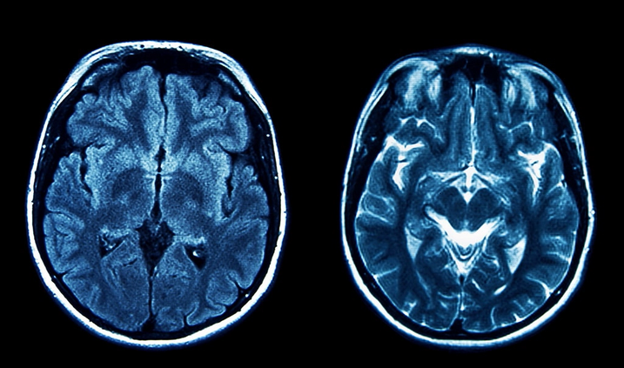
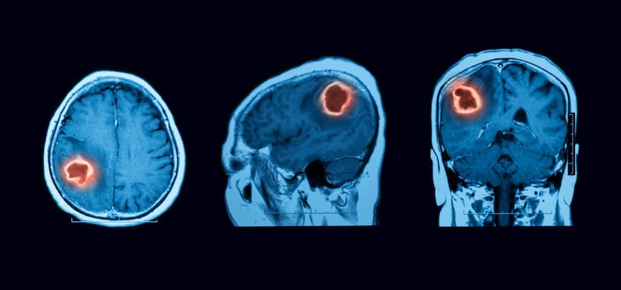
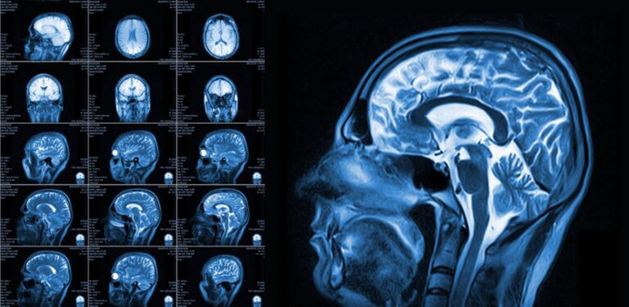
Introduction
What is a brain tumor?
A brain tumor is a collection, or mass, of abnormal cells in your brain. Your skull, which encloses your brain, is very rigid. Any growth inside such a restricted space can cause problems. Brain tumors can be cancerous (malignant) or noncancerous (benign). When benign or malignant tumors grow, they can cause the pressure inside your skull to increase. This can cause brain damage, and it can be life-threatening.

Slide 4

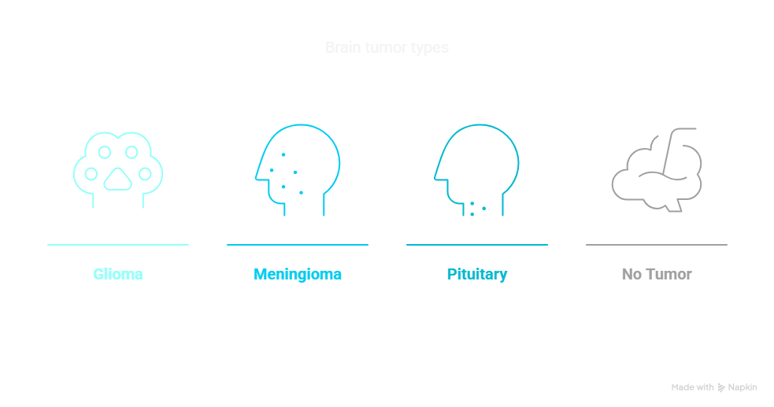
Primary Goal
Develop an automated machine learning system that classifies brain tumors from MRI scans into four categories with high accuracy.

Slide 5
Dataset Overview
Dataset Source & Structure
  Origin of the Data
  The dataset consists of brain MRI scans collected from medical repositories or hospitals.
  Common public sources:
    Figshare (Brain Tumor Dataset)
    BraTS (Brain Tumor Segmentation Challenge)
    Kaggle (e.g., Brain MRI Images for Brain Tumor Detection)
2. MRI Image Characteristics
Technical Specifications:
  Format: .jpg or .png (common in public datasets).
  Dimensions: Vary (e.g., 512x512 original → resized to 64x64 for model input).
  Color Mode:
    Grayscale (1 channel) for simplicity.
    RGB (3 channels) if color features are relevant.
  Artifacts: Some scans may have noise (motion blur, machine artifacts).

Slide 6
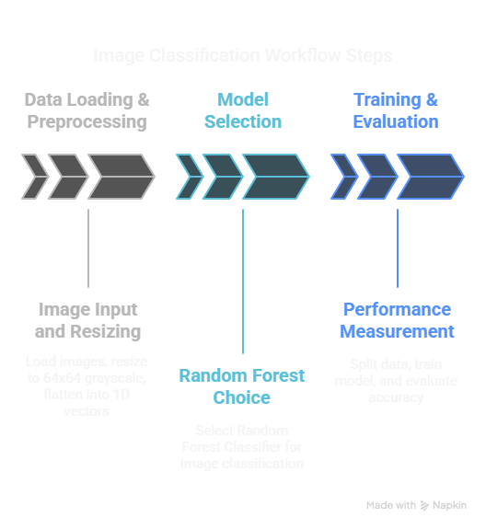
Methodology
Step 1: Data Loading & Preprocessing
  OpenCV for image reading and resizing (64x64 grayscale).
  NumPy for array conversion.
  Flattening images into 1D vectors (64x64 = 4096 features).
Step 2: Model Selection
  Random Forest Classifier (scikit-learn).
    Ensemble method, good for image classification.
    Handles high-dimensional data well.
Step 3: Training & Evaluation
  Train-Test Split.
  Accuracy Score for performance measurement.

Slide 7
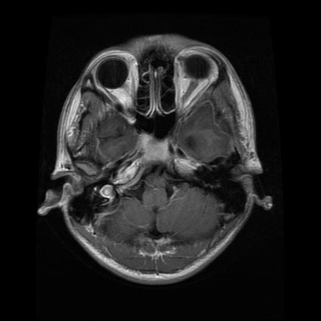
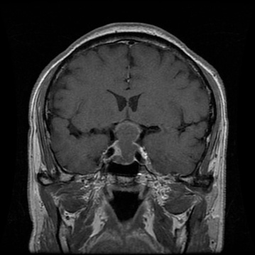
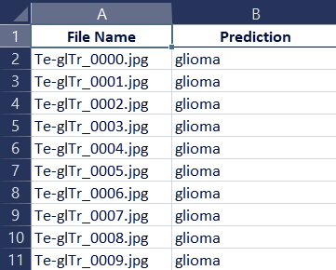
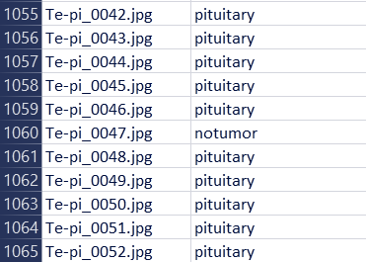
Results & Performance
Model Evaluation
  Accuracy: 93% ~ 94%
  Sample Predictions:
File name: Te-glTr_0003.jpg
Prediction: glioma
File name: Te-pi_0295.jpg
Prediction: pituitary

Slide 8
Conclusion
The Brain Tumor Classification project demonstrates the power of machine learning in medical imaging, providing a fast and automated way to detect and categorize brain tumors from MRI scans. By leveraging Random Forests, we achieved a structured approach to classifying gliomas, meningiomas, pituitary tumors, and healthy scans, paving the way for AI-assisted diagnostics.

Slide 9
Thank You!
Thank you for exploring the world of AI with us.

